Slide 1
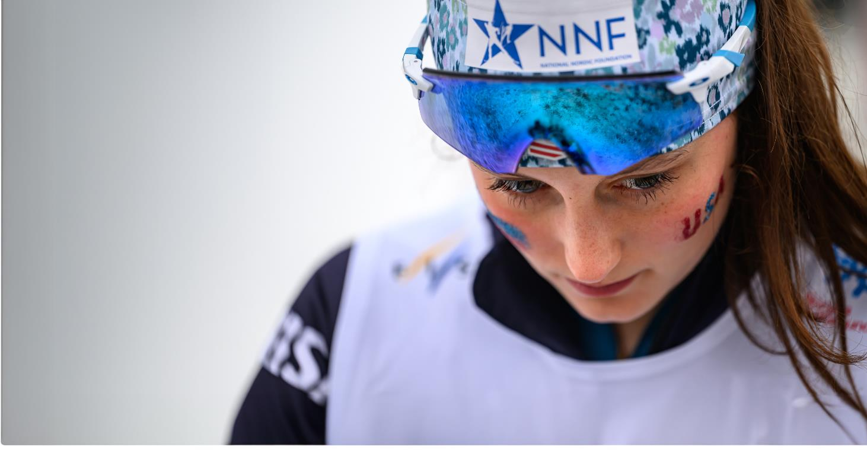
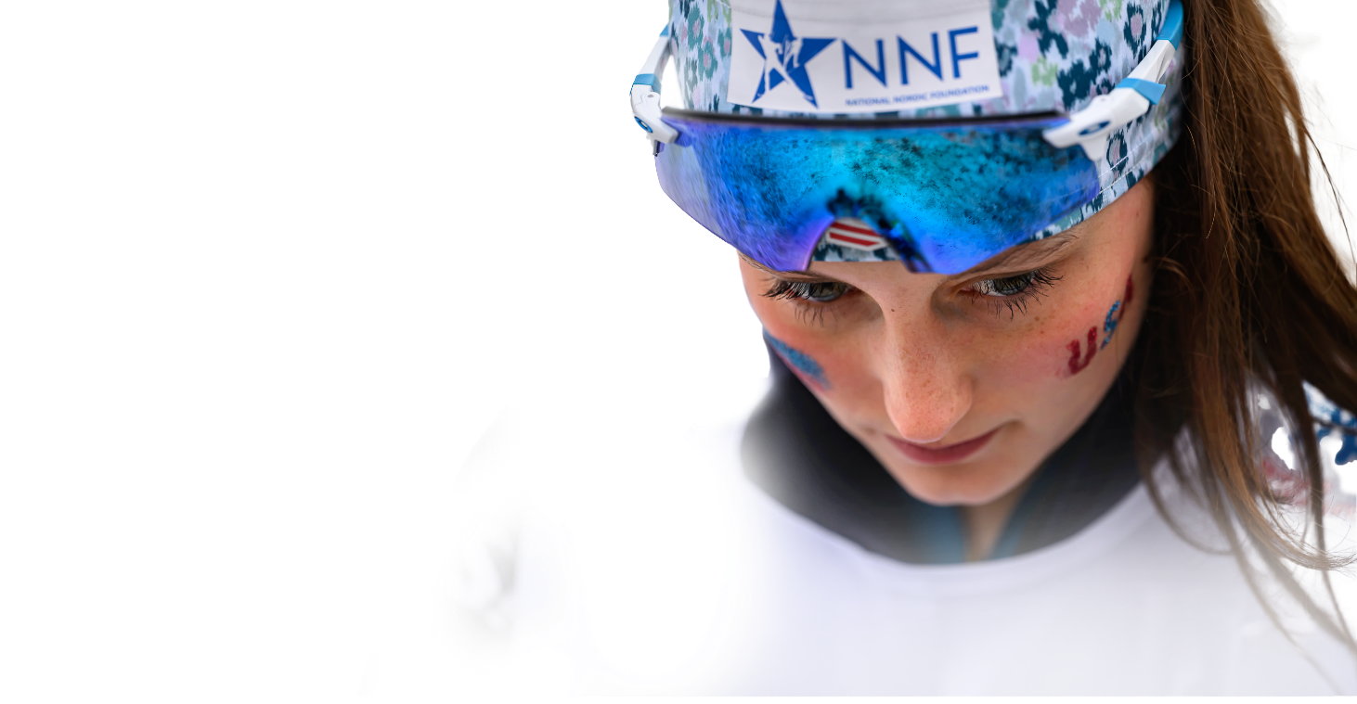

2025-2026
IMPACT REPORT
Photo Credit: Steve Fuller

Slide 2
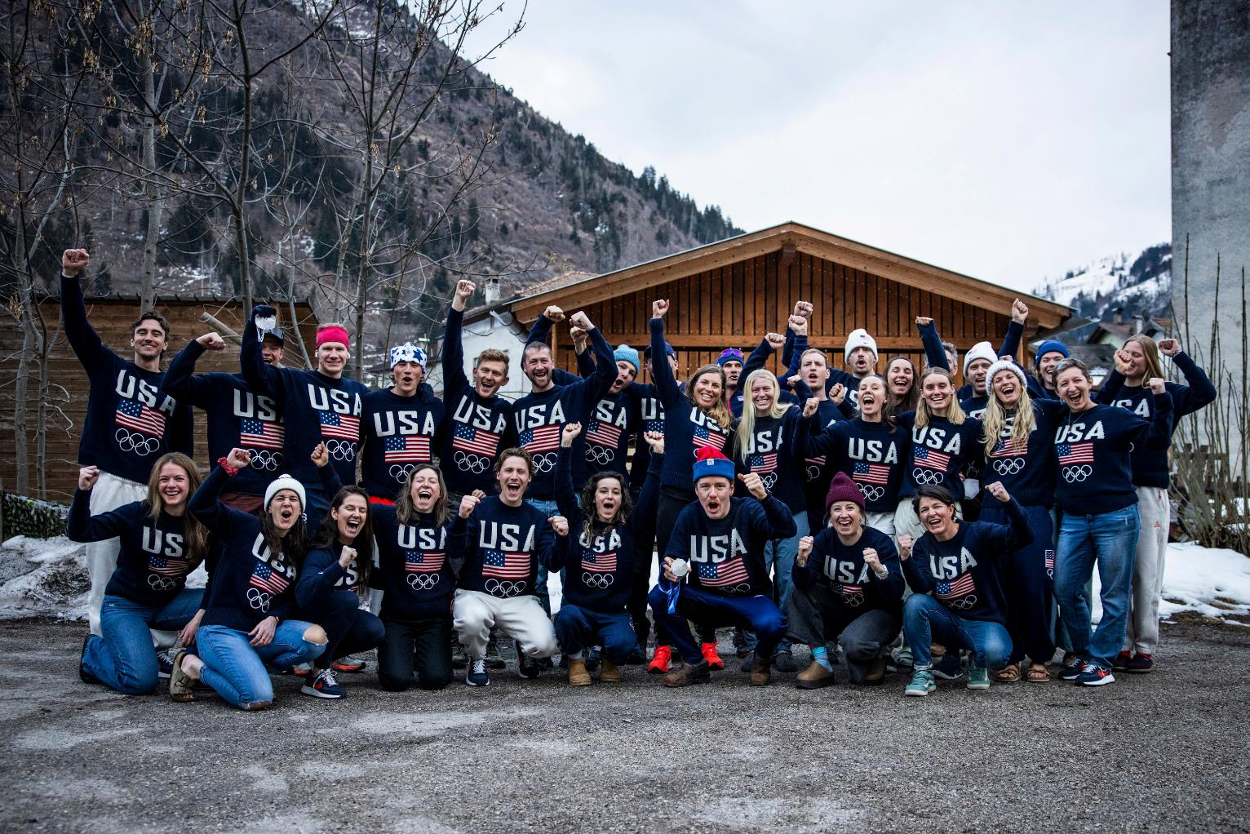

MISSION
Power the opportunities that bridge the gap to World Cup and Olympic excellence for developing Nordic skiers from the United States.
Photo Credit: @gpowersfilm

Slide 3
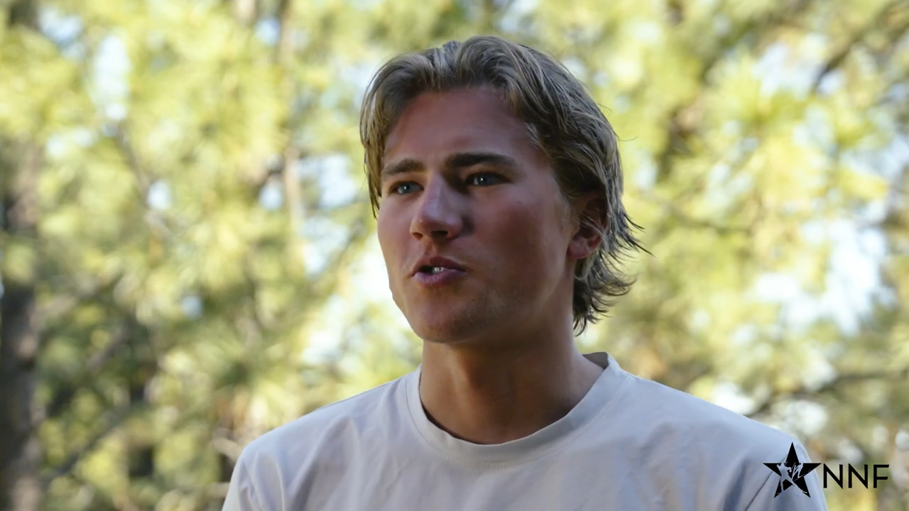

Slide 4
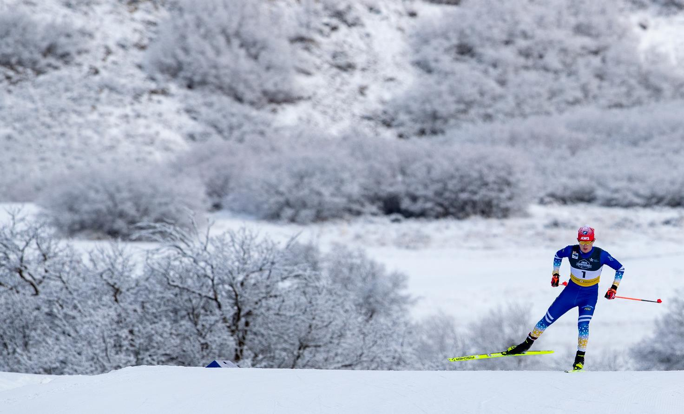

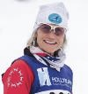

Dear U.S. Nordic Community,
The 2025–26 season was monumental as Jessie Diggins and Rosie Brennan, two of the most accomplished athletes in U.S. cross-country skiing history, skied into retirement. At the same time, a new chapter emerged on the men’s side. Following several years of steady progress, highlighted by recent World Cup podiums and World Championship success, the U.S. men reached a new level at the Olympic Winter Games.
It was incredibly emotional for me to witness those accomplishments firsthand. Watching Ben Ogden crest the final hill in the Olympic Sprint and enter the stadium behind only one athlete—who happens to be the greatest Nordic skier of all time—and ahead of the rest of the field to secure the first U.S. men's Olympic medal in cross-country skiing in 50 years was unforgettable. Just days later, Ben and Gus Schumacher stood together on the Olympic podium after a remarkable Team Sprint performance. In that moment, hundreds of American fans experienced something that supporters of our women's team have felt for years: expectation. These breakthroughs reflect what happens when belief meets opportunity, and that opportunity is made possible by your support of the NNF.
Back home in March, the World Cup Finals in Lake Placid showcased how far our sport has come in the United States. At only our second home World Cup in two decades, the energy, enthusiasm, and spectator support were unlike anything I have seen in my career. What was once viewed by many European athletes as a difficult travel stop has become one of the most anticipated venues on the World Cup circuit.
Of course, this level of success begins long before athletes reach the World Cup. It starts with a dream, an opportunity, and an early commitment to development. Many of the athletes who contributed to this season’s success benefited directly from NNF support at key moments in their development. With each camp, race trip, and training season, young athletes gain more than experience; they build confidence, purpose, and community. To strengthen this pathway, NNF is expanding support for youth and development programming, including the National U16 Camp, Regional Elite Group and National Development Group camps, the U18 SuperTrip, and the World Junior and U23 World Championships. These investments allow more athletes to access transformative development opportunities and help strengthen the depth of talent across the United States. NNF also continues to support summer training grants and unfunded World Cup athletes, helping bridge critical gaps throughout the athlete pathway.
The results of the 2025–26 season reflect NNF’s mission: To power the opportunities that bridge the gap to World Cup and Olympic excellence for developing Nordic skiers in the United States. That mission is unfolding before our eyes, and it is happening because people like you continue to show up with your belief, generosity, and trust in what we are building together.
Thank you,
Laura McCabe Chairperson, NNF Board of Directors
CHAIRPERSON’S LETTER
Photo Credit: Reese Brown

Slide 5
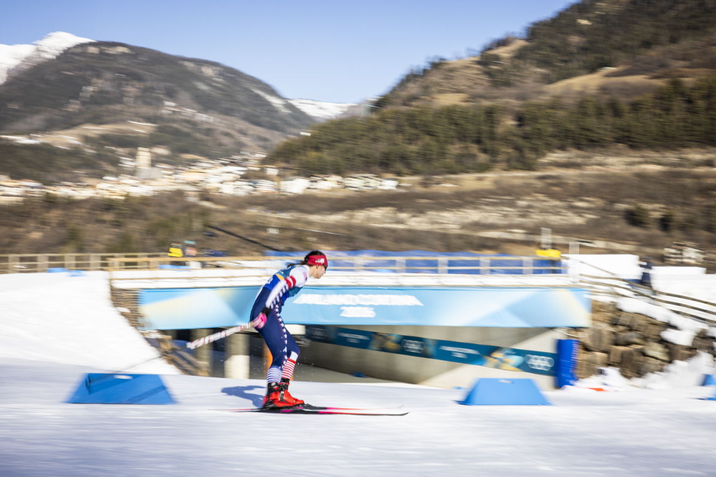

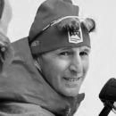
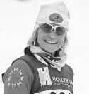
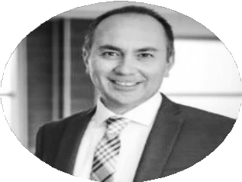
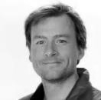
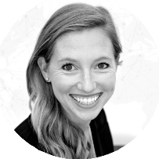
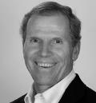
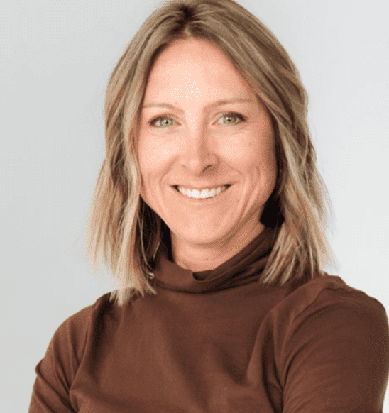
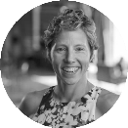
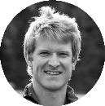
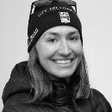
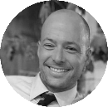
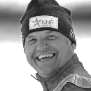
Administration
Board of Directors
Reese Brown
Laura McCabe
Chairperson
Thomas Pearce
Vice Chair
Gus Kaeding
Treasurer
Erika Flowers
Secretary
Craig Ward
Lia Prysunka
Kikkan Randall
Colin Rodgers
Sophie Caldwell
Hamilton
Matt Whitcomb
Yuriy Gusev
Photo Credit: @gpowersfilm

Slide 6
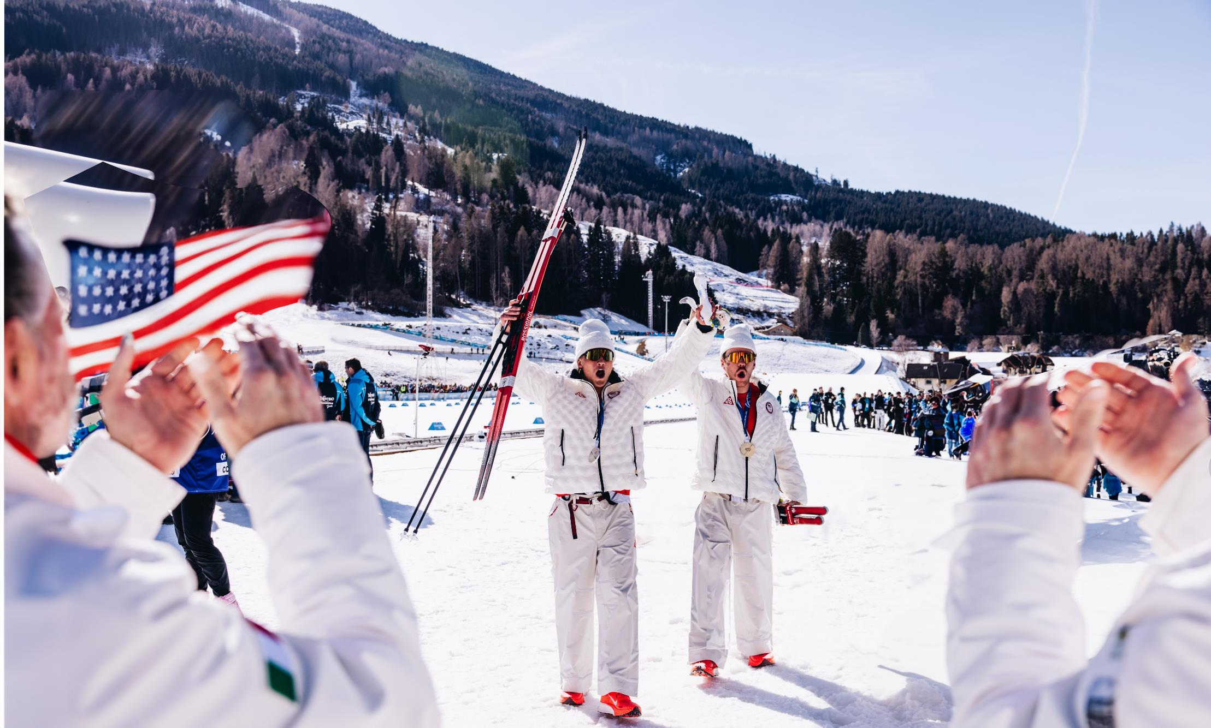
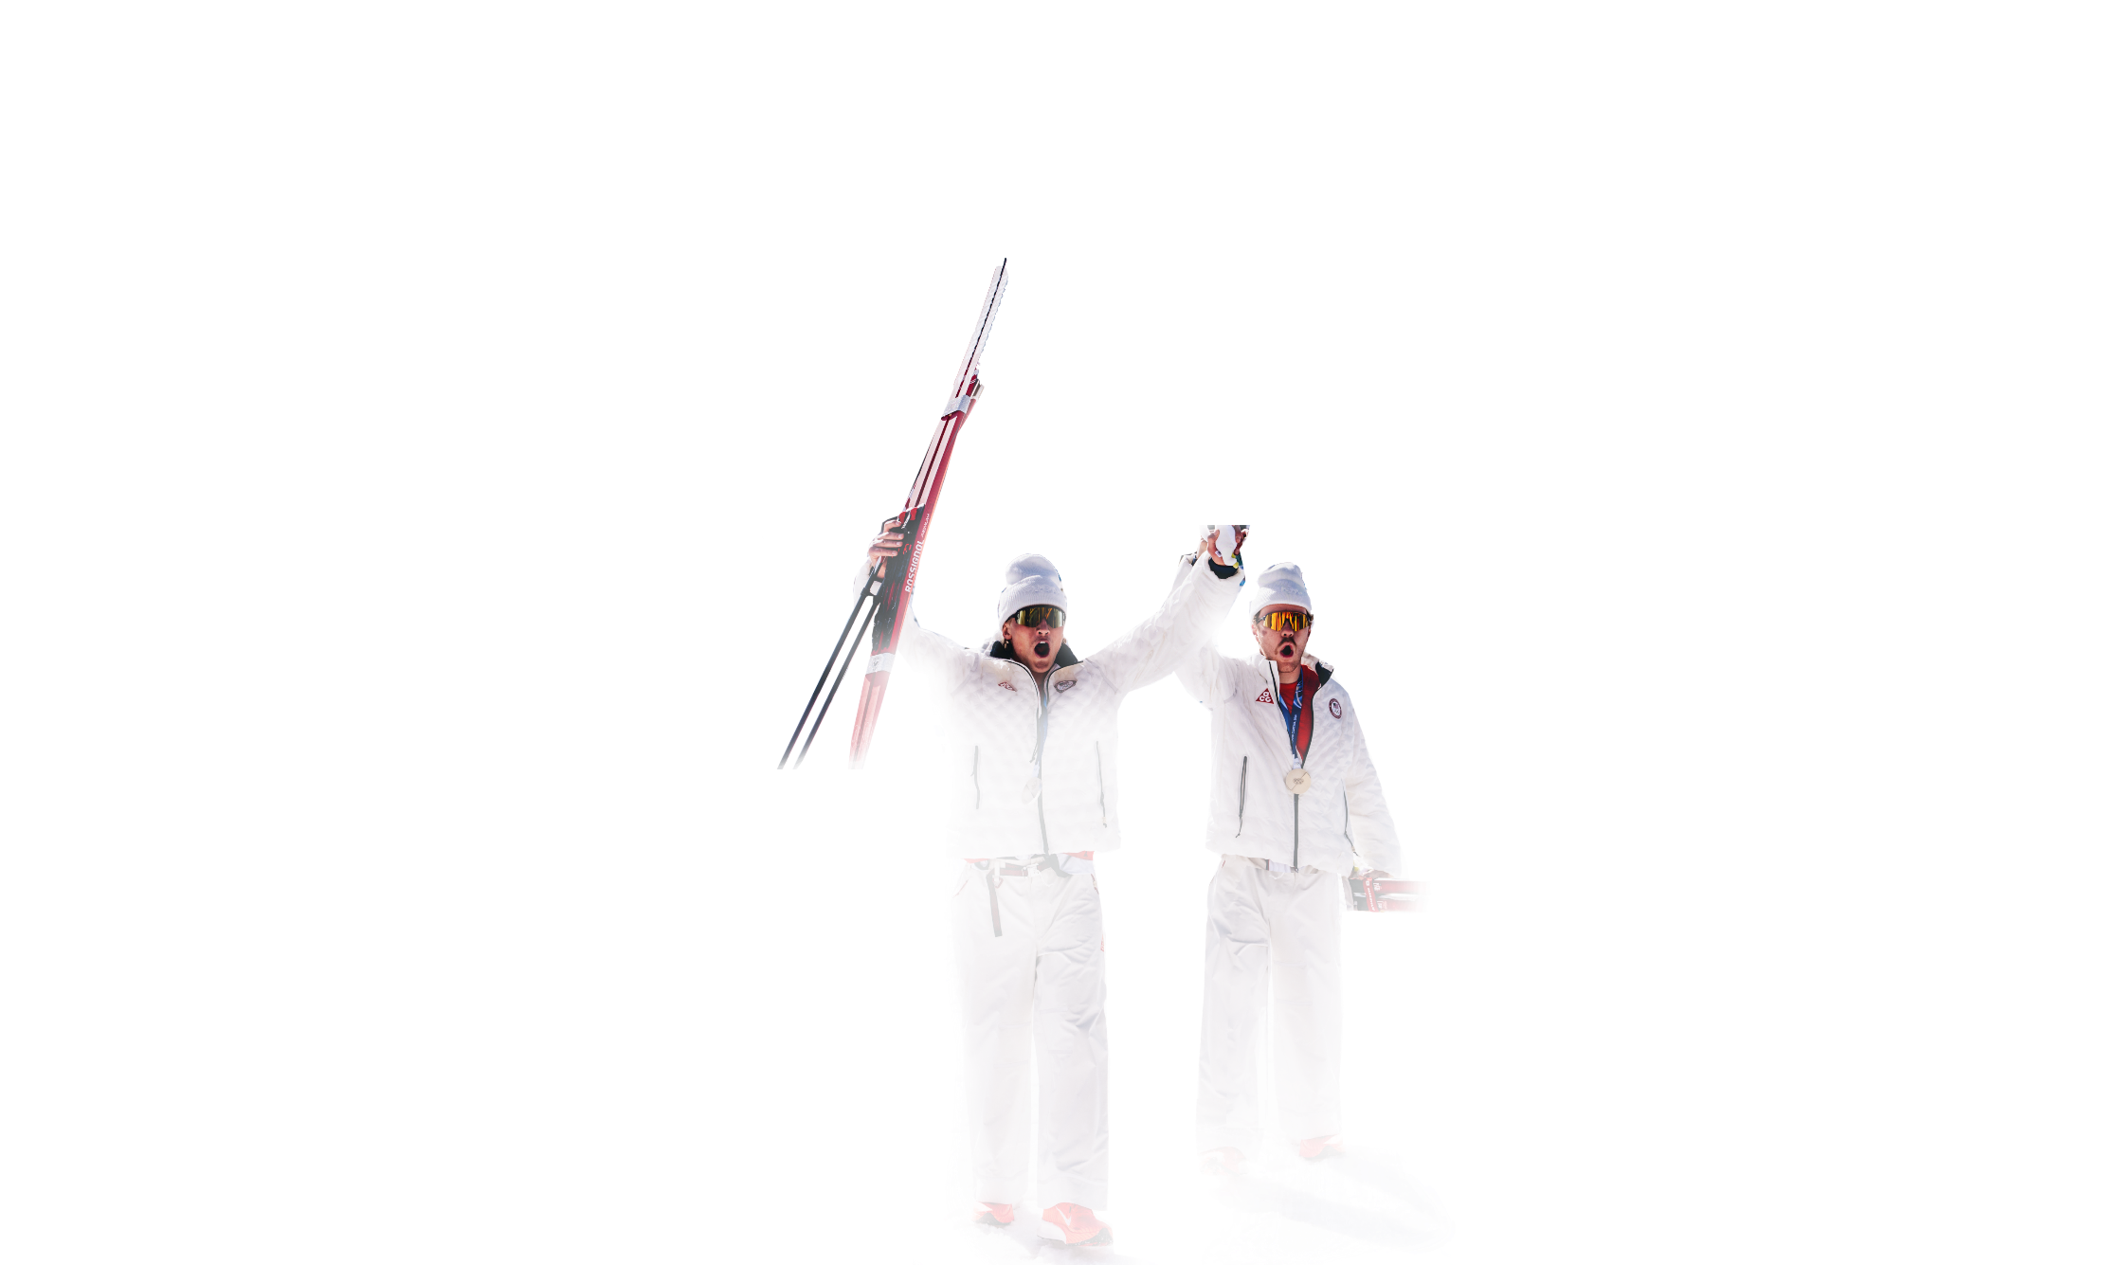
Fundraising Elements
Major donation & Board Drive
$454,901
2025-2026
Expenses
Drive for 25
$667,273
$159,429
Online Auction
$27,131
raised
Special Campaigns
$25,812
Photo Credit: @gpowersfilm

Slide 7
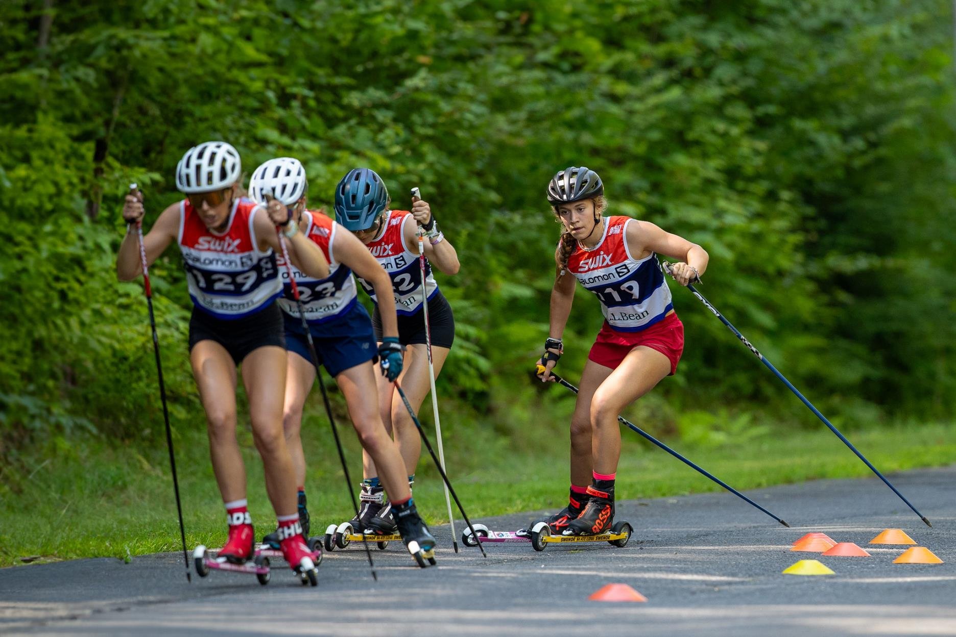
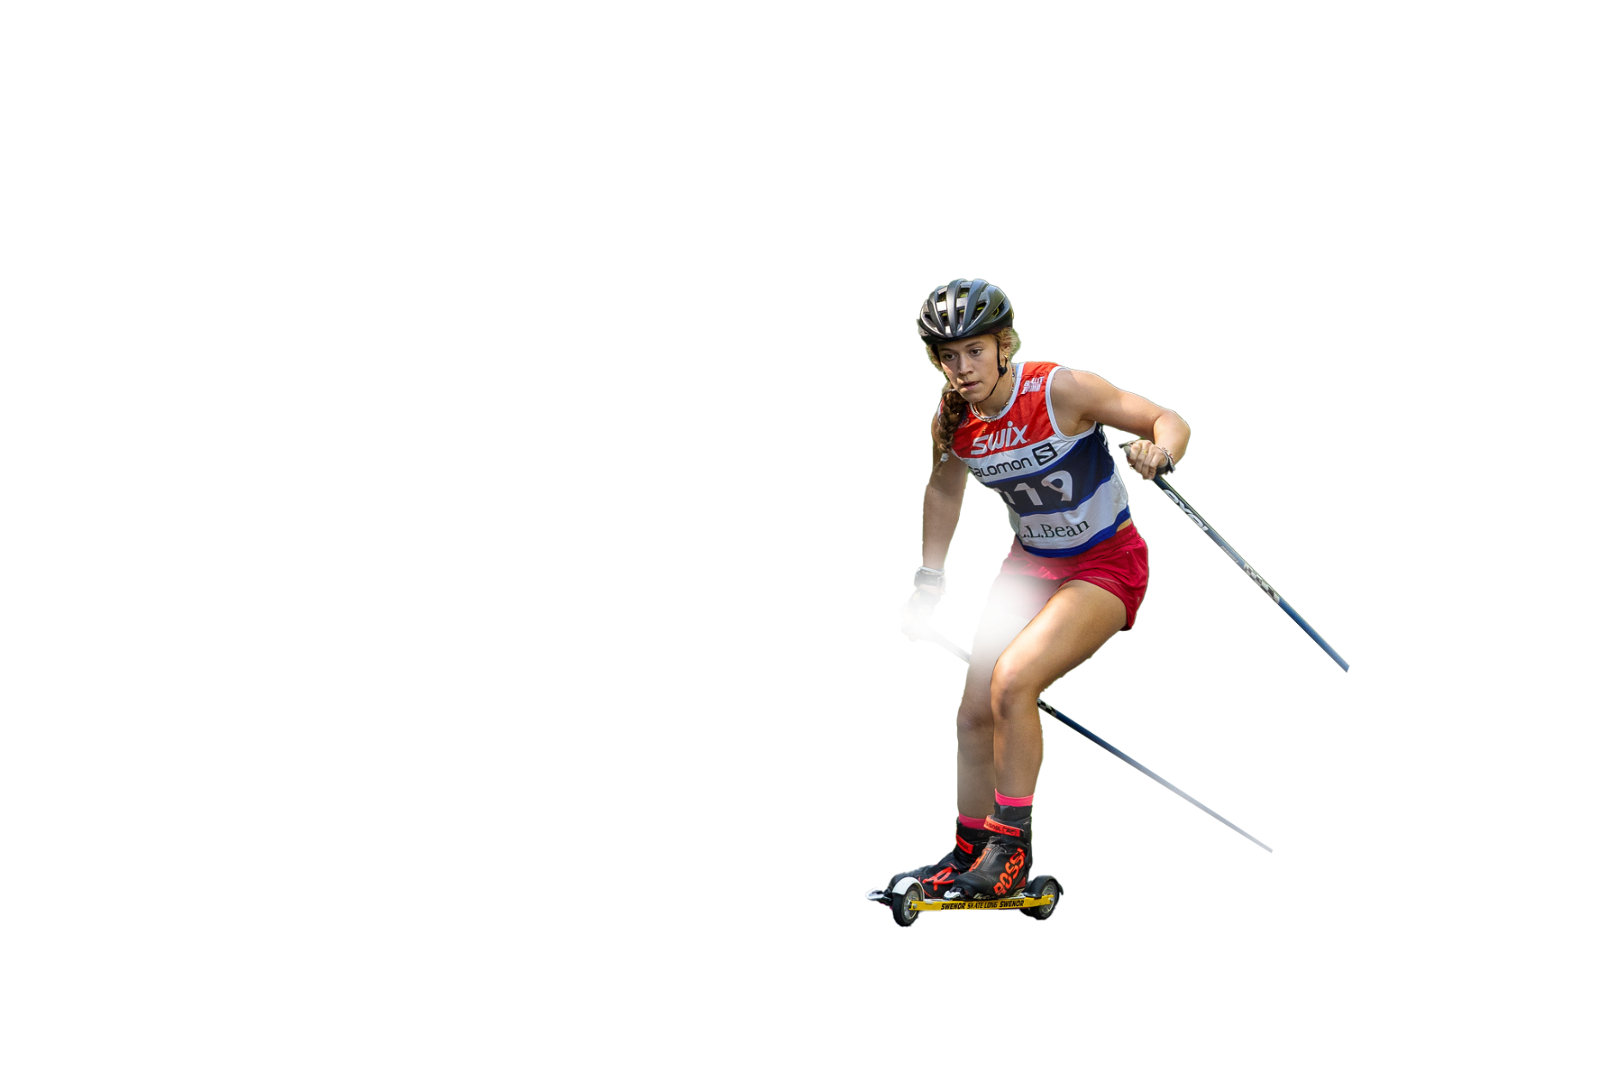
Supported SUMMER PROJECTS
ATHLETE GRANTS
$25,500
2025-2026
U16 NATIONAL CAMP
$100,628
$21,971
REGIONAL ELITE GROUP
(REG) CAMPS
$20,057
Invested to support athletes
NATIONAL Development GROUP (NDG) CAMPS
$18,100
Nordic Combined Grant
$15,000
Photo Credit: Reese Brown

Slide 8
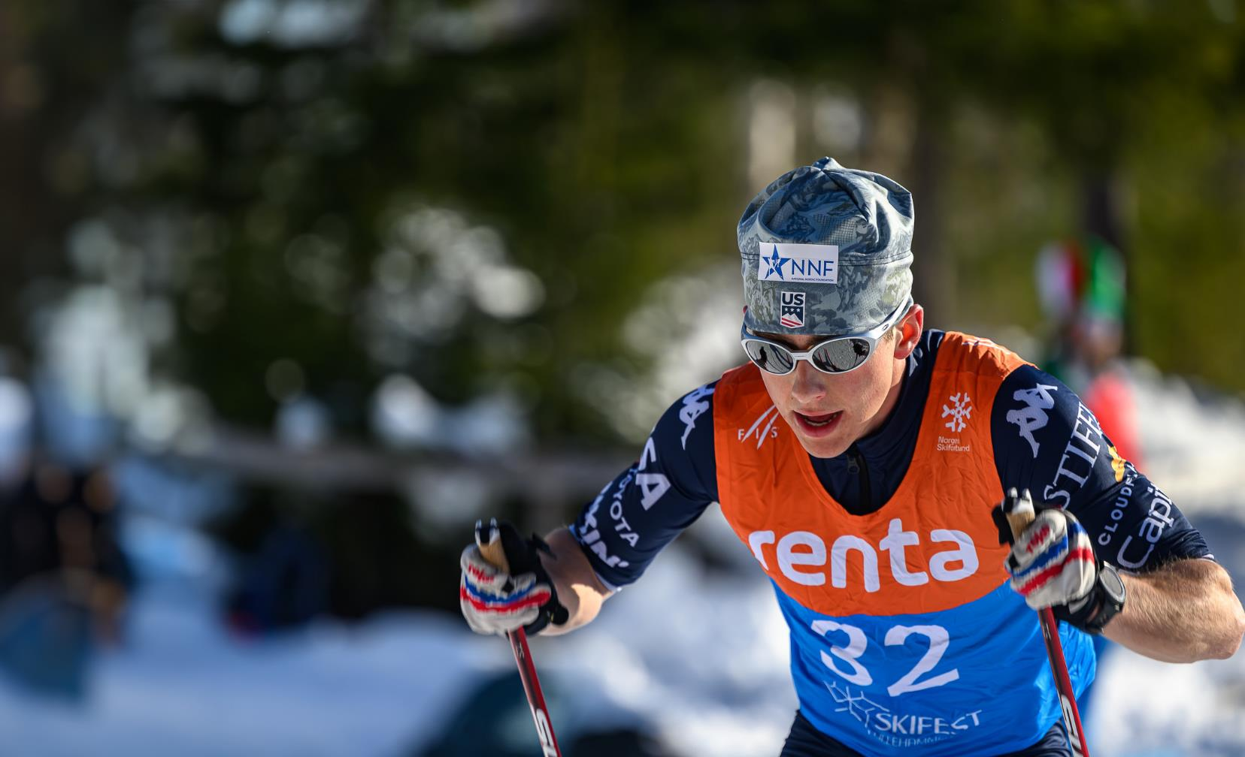
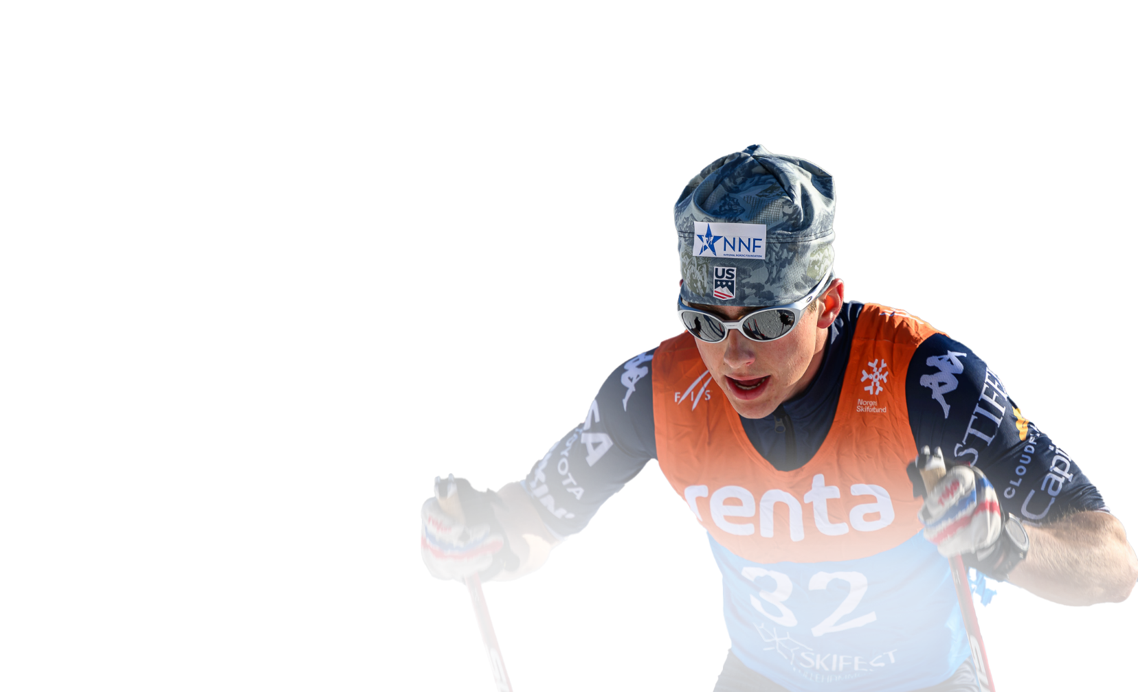
Supported Winter PROJECTS
JUNIOR WORLDS/U23 CHAMPIONSHIPS
$78,100
U18 / SENIOR SUPER TRIP
$64,000
2025-2026
World Cup athlete Grants
$228,485
$32,229
SUPERTOUR
$27,275
Invested to support athletes
TRAIL TO GOLD Coaching Grants
$18,881
Nordic Combined
Photo Credit: Steve Fuller
$8,000

Slide 9
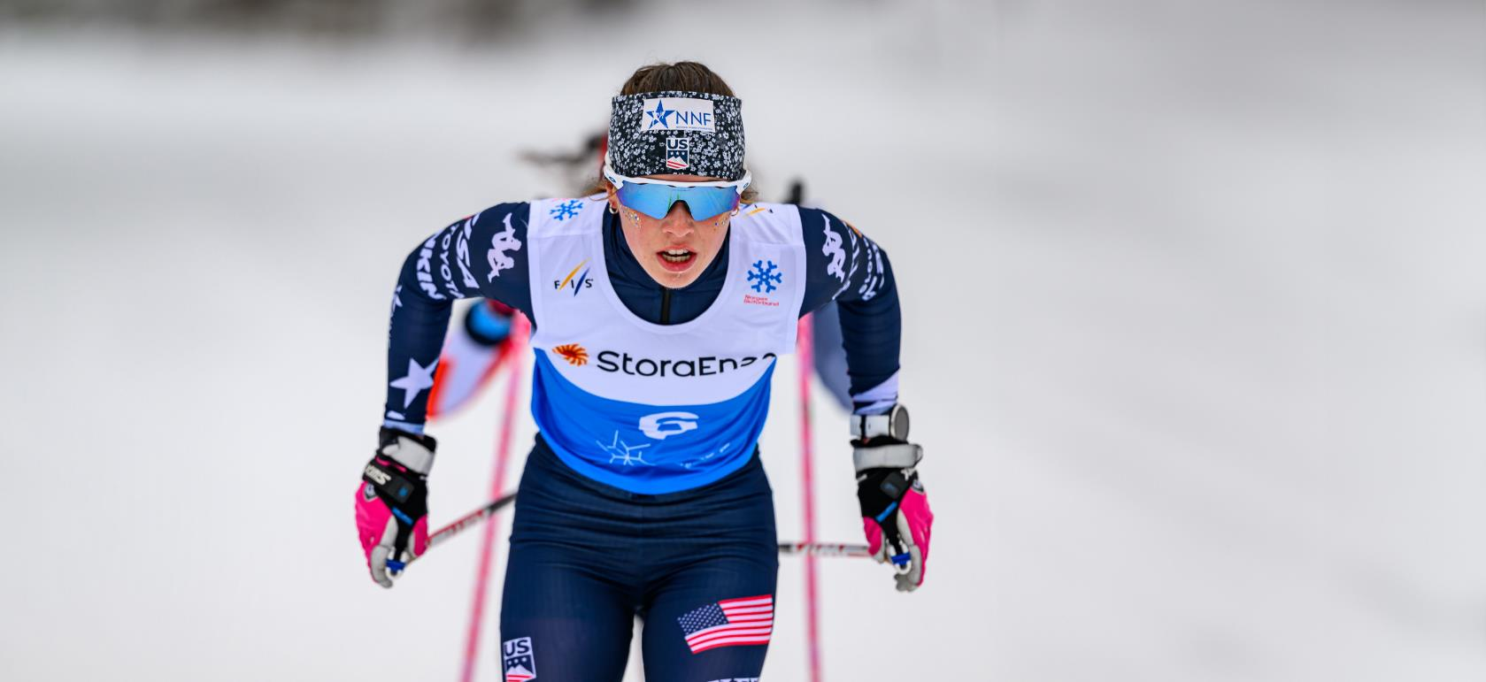
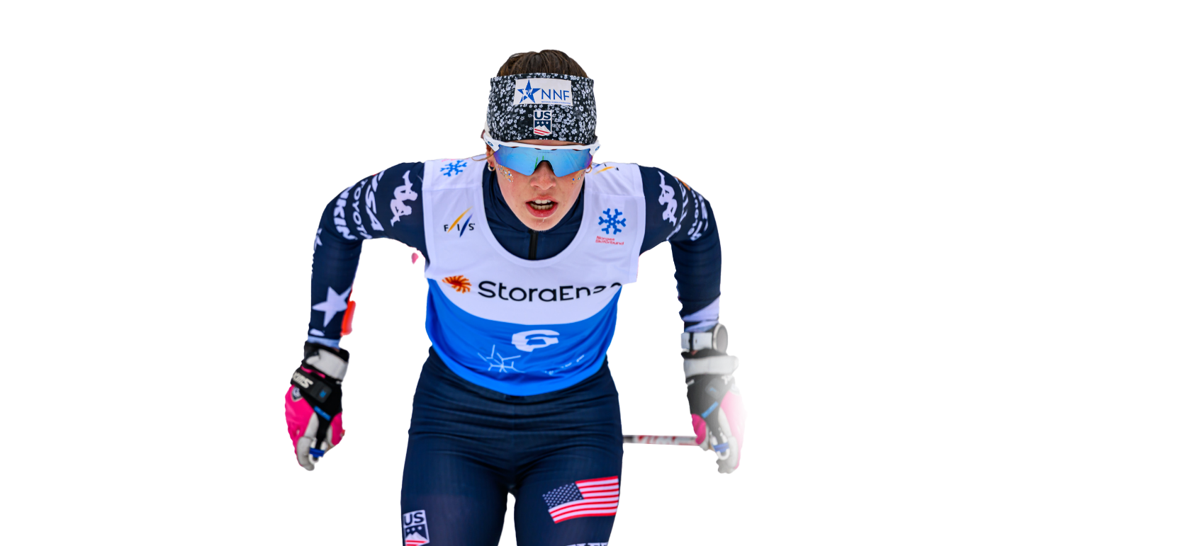
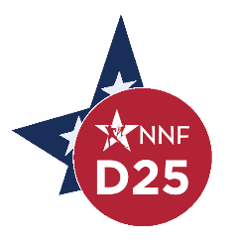
Drive for 25
2025-2026
1,256
Individual Donations
$159,429
Raised by Our Grassroots Community
Photo Credit: Steve Fuller

Slide 10
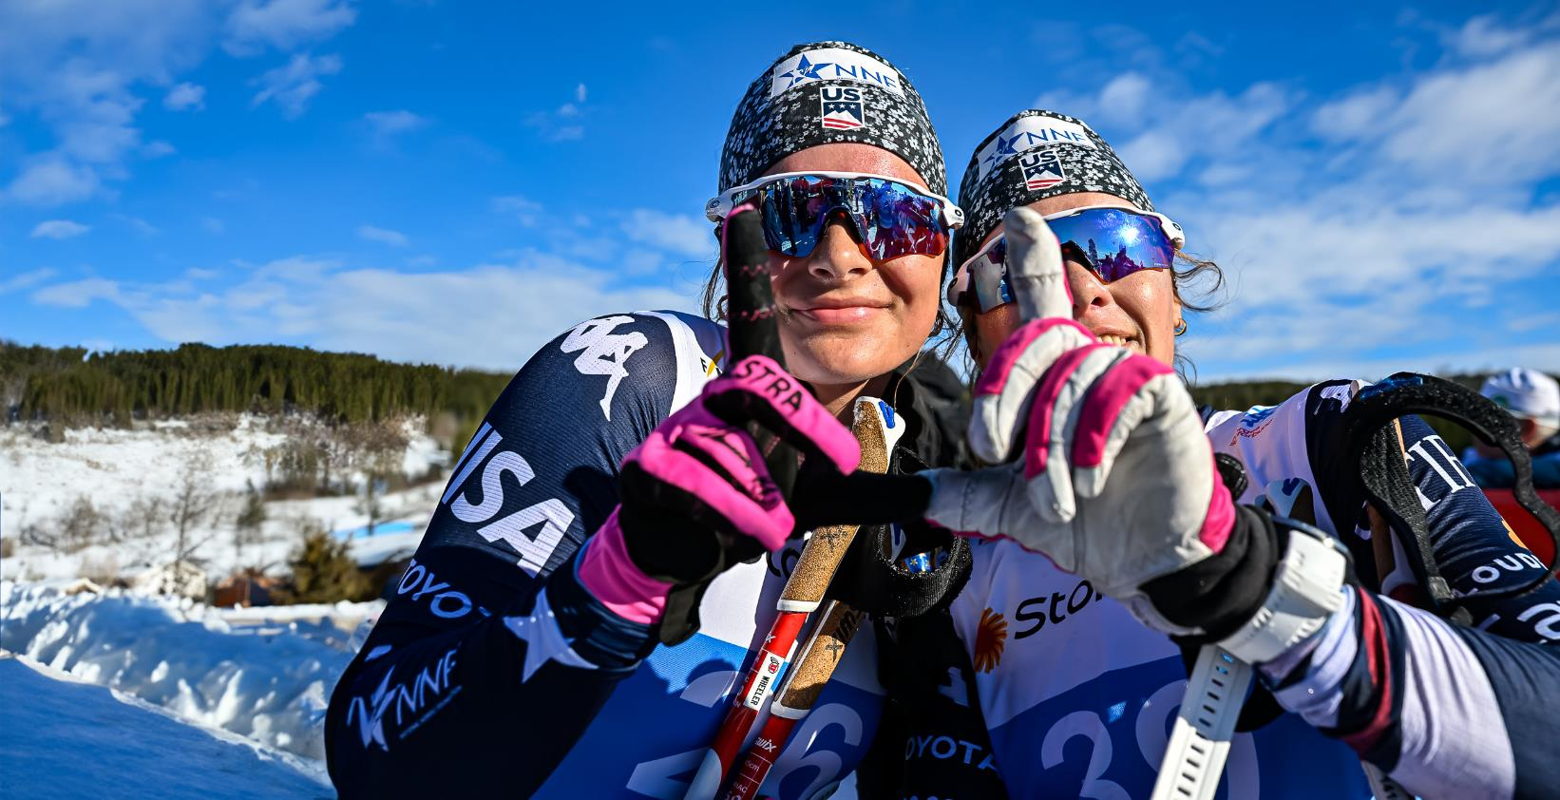
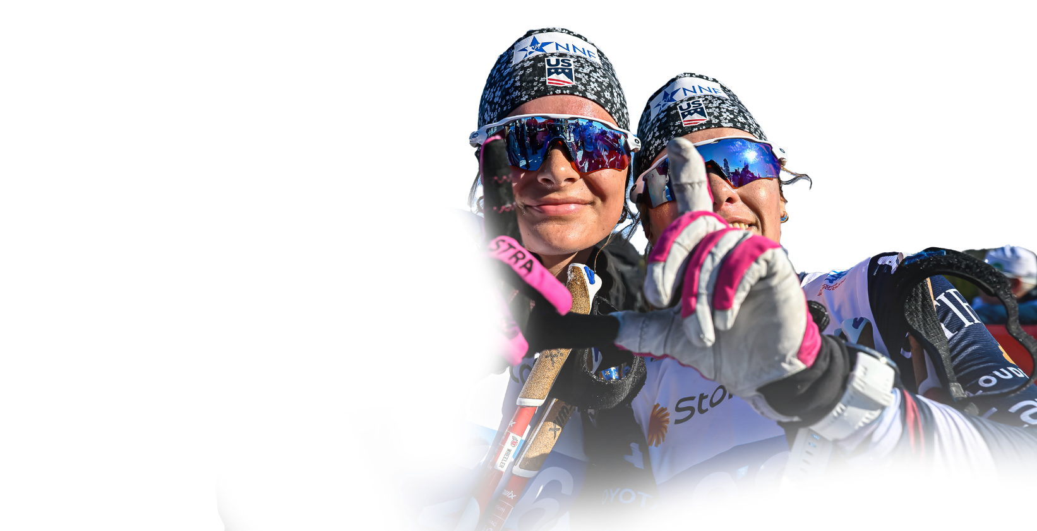

EXPENSES FY 2025 - 2026
Photo Credit: Steve Fuller

Slide 11
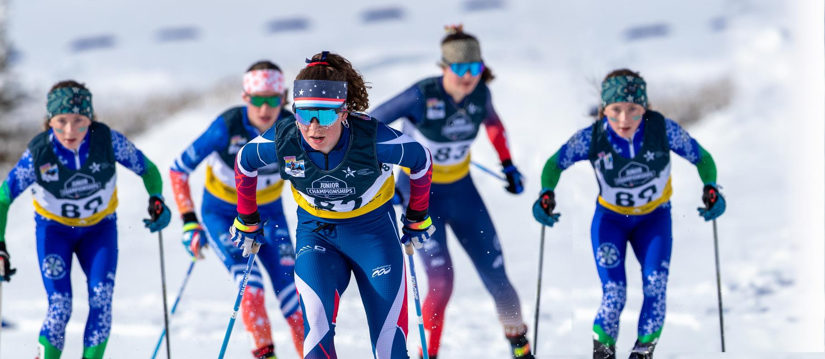
SEASON HIGHLIGHTS
FOR NNF-FUNDED ATHLETES
U18 SCANDINAVIAN CHAMPIONSHIPS
U18 SuperTrip 5/7.5k
Linnea Ousdigian: 3rd
Tula Higman: 4th
Gabe Black: 7th
U18 SuperTrip Sprint
Linnea Ousdigian: 13th
U18 SuperTrip 7.5/10k
Linnea Ousdigian: 1st
Georgia Bishop: 5th
Matthew McIntosh: 6th
U18 Nordic Nations 10k
Tula Higman: 6th
U18 Nordic Nations Sprint
Ian Carmack: 5th
Linnea Ousdigian: 11th
Tula Higman: 14th
U18 Nordic Nations 15k
Linnea Ousdigian: 3rd
Tula Higman: 5th
Georgia Bishop: 9th
Miya Kam-Magruder: 14th
Aili Scott: 15th
Gabe Black: 15th
Photo Credit: Reese Brown

Slide 12
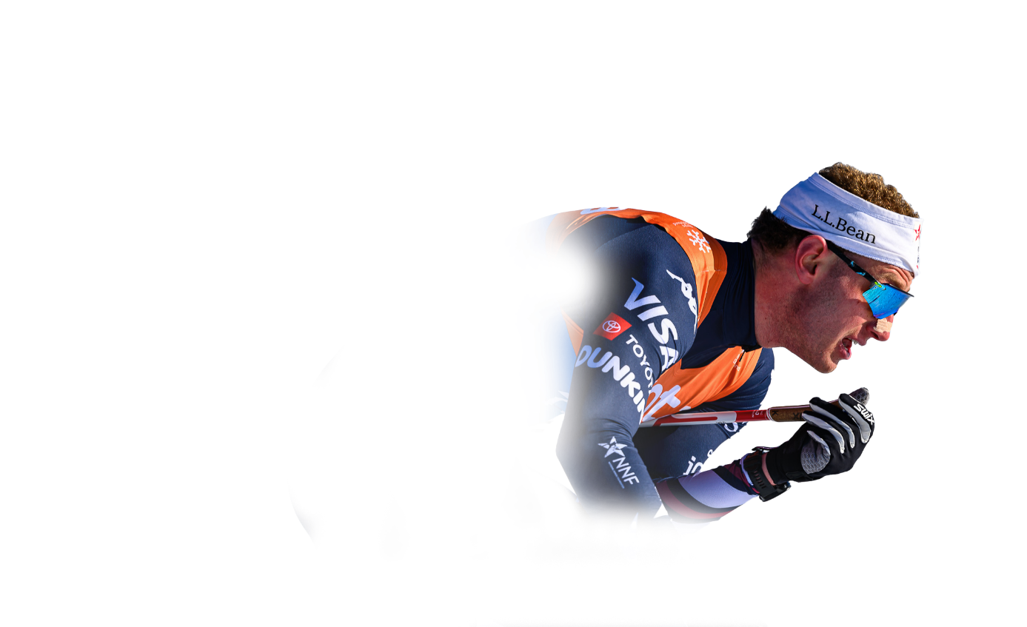
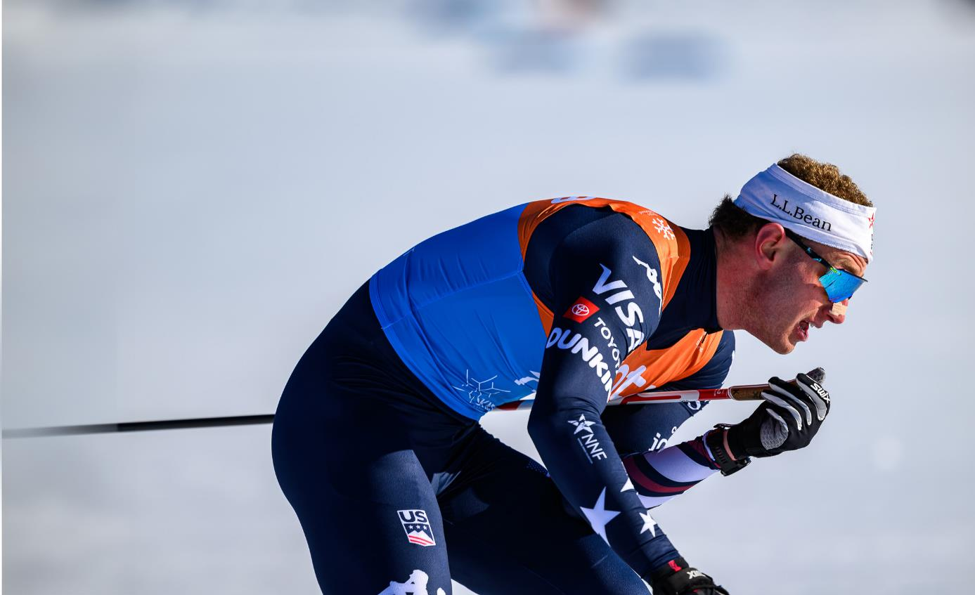
SEASON HIGHLIGHTS
FOR NNF-FUNDED ATHLETES
JR/U23 WORLD CHAMPIONSHIPS
World Junior Sprint
Murphy Kimball: 6th
World Junior 20k
Neve Gerard: 9th
Ally Wheeler: 11th
Tabor Greenberg: 10th
World Junior 10k
Jack Leveque: 10th
Neve Gerard: 11th
Natalie Nicholas: 14th
U23 World
Championships Sprint
Samantha Smith: 7th
Ava Thurston: 9th
Haley Brewster: 13th
U23 World Championships 20k
Corbin Carpenter: 10th
Ava Thurston: 9th
Haley Brewster: 12th
U23 World Championships 10k
Corbin Carpenter: 13th
Ava Thurston: 15th
Photo Credit: Steve Fuller

Slide 13
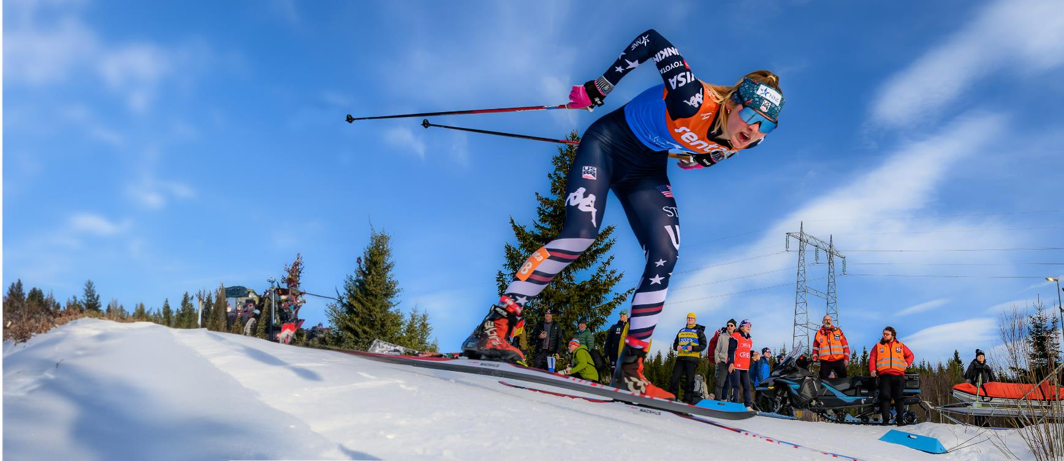
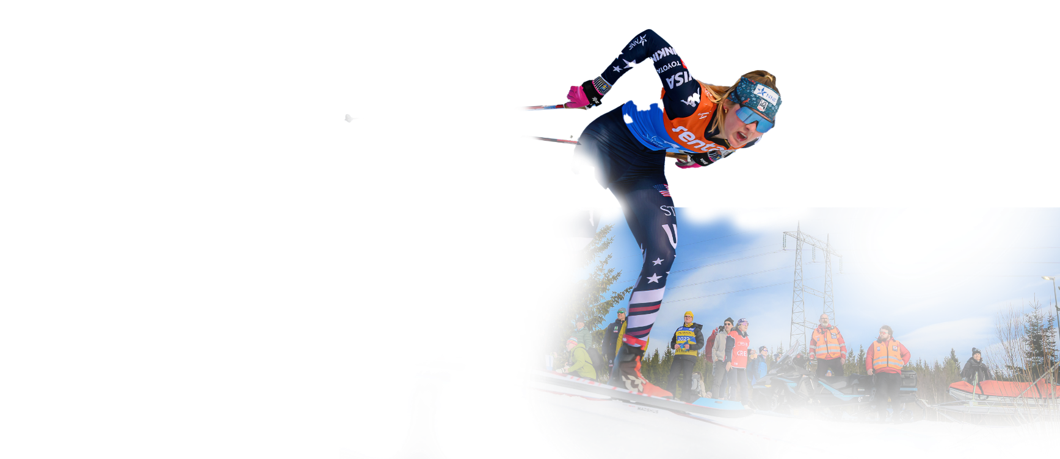

SEASON HIGHLIGHTS
FOR NNF-FUNDED ATHLETES
133 WORLD CUP STARTS
(NUMBER OF STARTS INDICATED)
Zak Ketterson (19)
Kevin Bolger (19)
Alayna Sonnesyn (14)
Kendall Kramer (13)
Luke Jager (10)
Hailey Swirbul (9)
Lauren Jortberg (8)
Zach Jayne (7)
Emma Albrecht (7)
Hunter Wonders (7)
Erin Bianco (6)
Luci Anderson (4)
Michael Earnhart (3)
Brian Bushey (3)
Owen Young (2)
John Schwinghamer (2)
Photo Credit: Steve Fuller

Slide 14
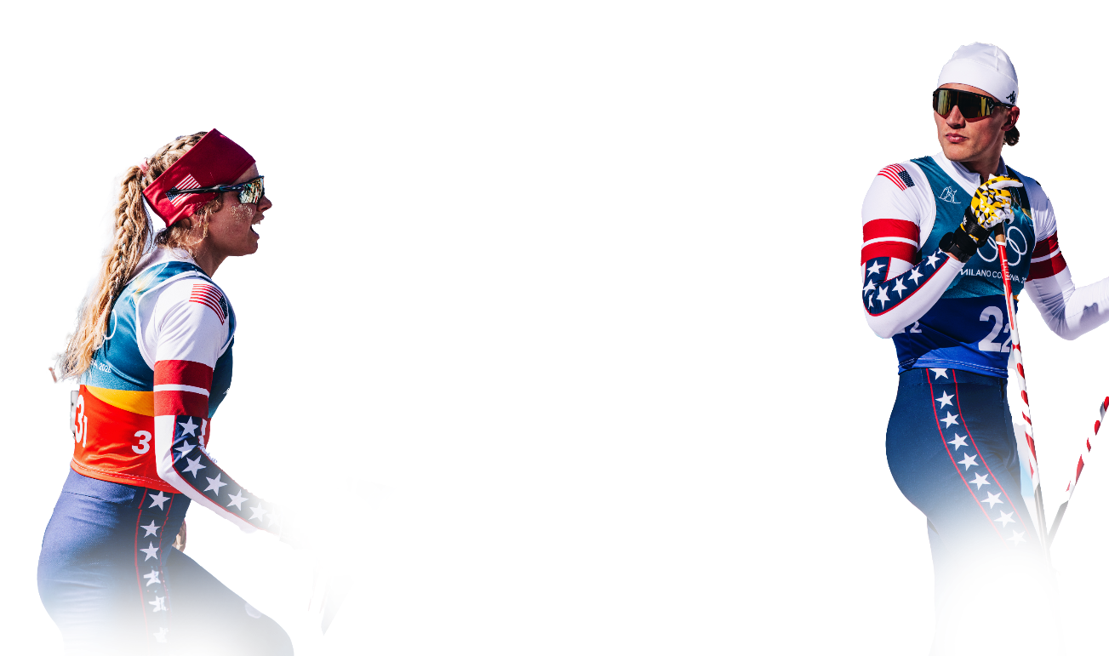
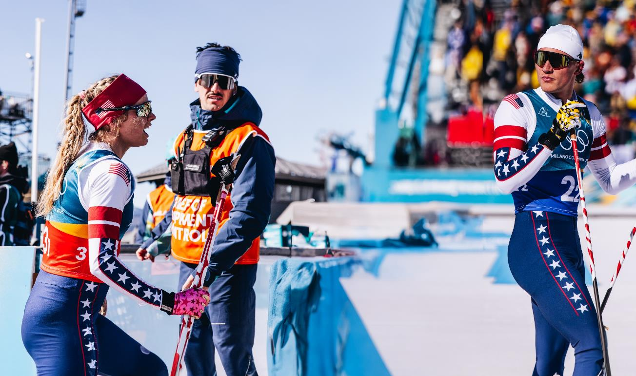

Photo Credit: @gpowersfilm
SEASON HIGHLIGHTS
FOR NNF-FUNDED ATHLETES
Top-30 World Cup Results
Kendall Kramer
9th Falun Skiathlon
25th Lake Placid 10k C +
28th 20k F
27th Goms 20k C
Zak Ketterson
9th Ruka 20k F + 14th 10k C
23rd Trondheim 10k F
18th Val di Fiemme Sp C
18th Goms 20k C
18th Holmenkollen 50k F
Kevin Bolger
15th Toblach Sp F
29th Falun Sp F
Hailey Swirbul
22nd Goms 20k C
24th Oberhof Sp F
Hunter Wonders
24th Oberhof 10k C
Luci Anderson
25th Davos 20k F
Alayna Sonnesyn
27th Davos Sp F
27th Ruka 20k F
Zach Jayne
27th Goms Sp C
Luke Jager
29th Oberhof 10k C
Lauren Jortberg
29th Oberhof Sp F

Slide 15
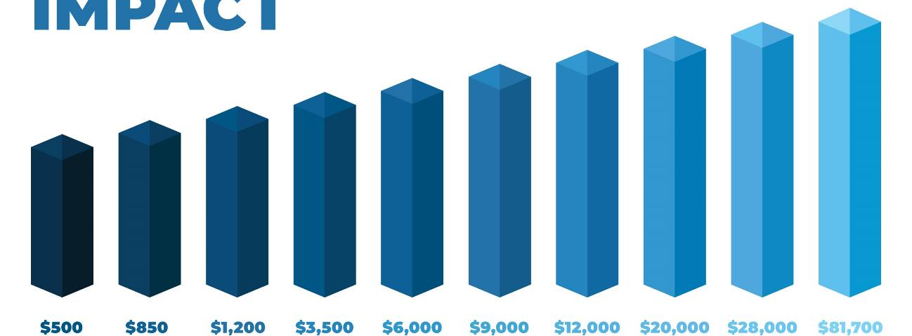
Your
Impact
5
Flies one of twelve young athletes to the National Elite Group Camp
in Utah.
Tickets an athlete to U18, World Junior, or U23 World Championships.
Supports the average value of our 16 Athlete Summer Training Grants.
Funds one of our eight Trail to Gold coaches for two weeks on the World Cup.
Sends two medical staff to World Junior
and U23 Championships.
Outfits 300 U16, REG, and NDG athletes with high-vis NNF road safety shirts.
Provides six rental vehicles for Team USA’s
World Junior Championships.
Underwrites NNF’s athlete summer training grant for one year.
Underwrites NNF’s Trail to Gold Women’s Coaching Grant for one year.
Underwrites NNF’s funding for World Juniors and U23 World Championships for one season.

Slide 16
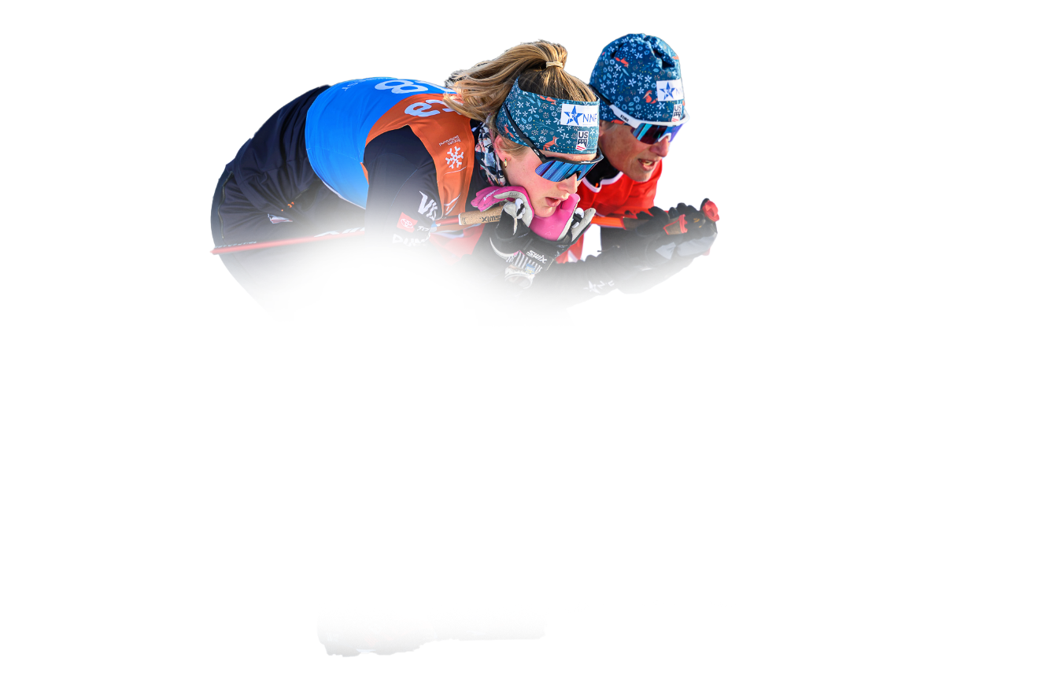
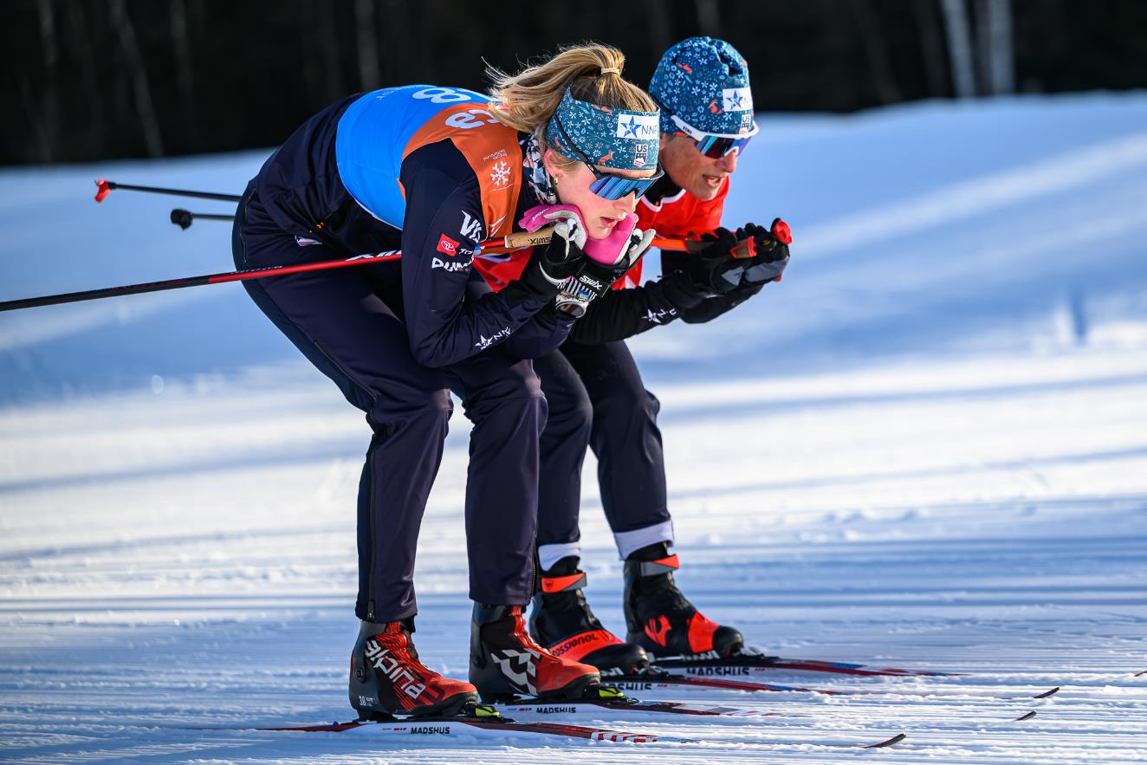

Photo Credit: Steve Fuller
Your Impact
If you are feeling inspired to contribute now, go to www.nationalnordicfoundation.org or scan this QR code or mail a check to PO Box 818, Woodstock, VT 05091
The NNF Philosophy: At NNF, we don't fully fund any one athlete or program. Instead, we partner with athletes, families, and clubs to help cover the costs of pursuing the Olympic dream. By sharing the journey together, we ensure that no dedicated athlete has to leave the sport because of financial barriers.

Slide 17
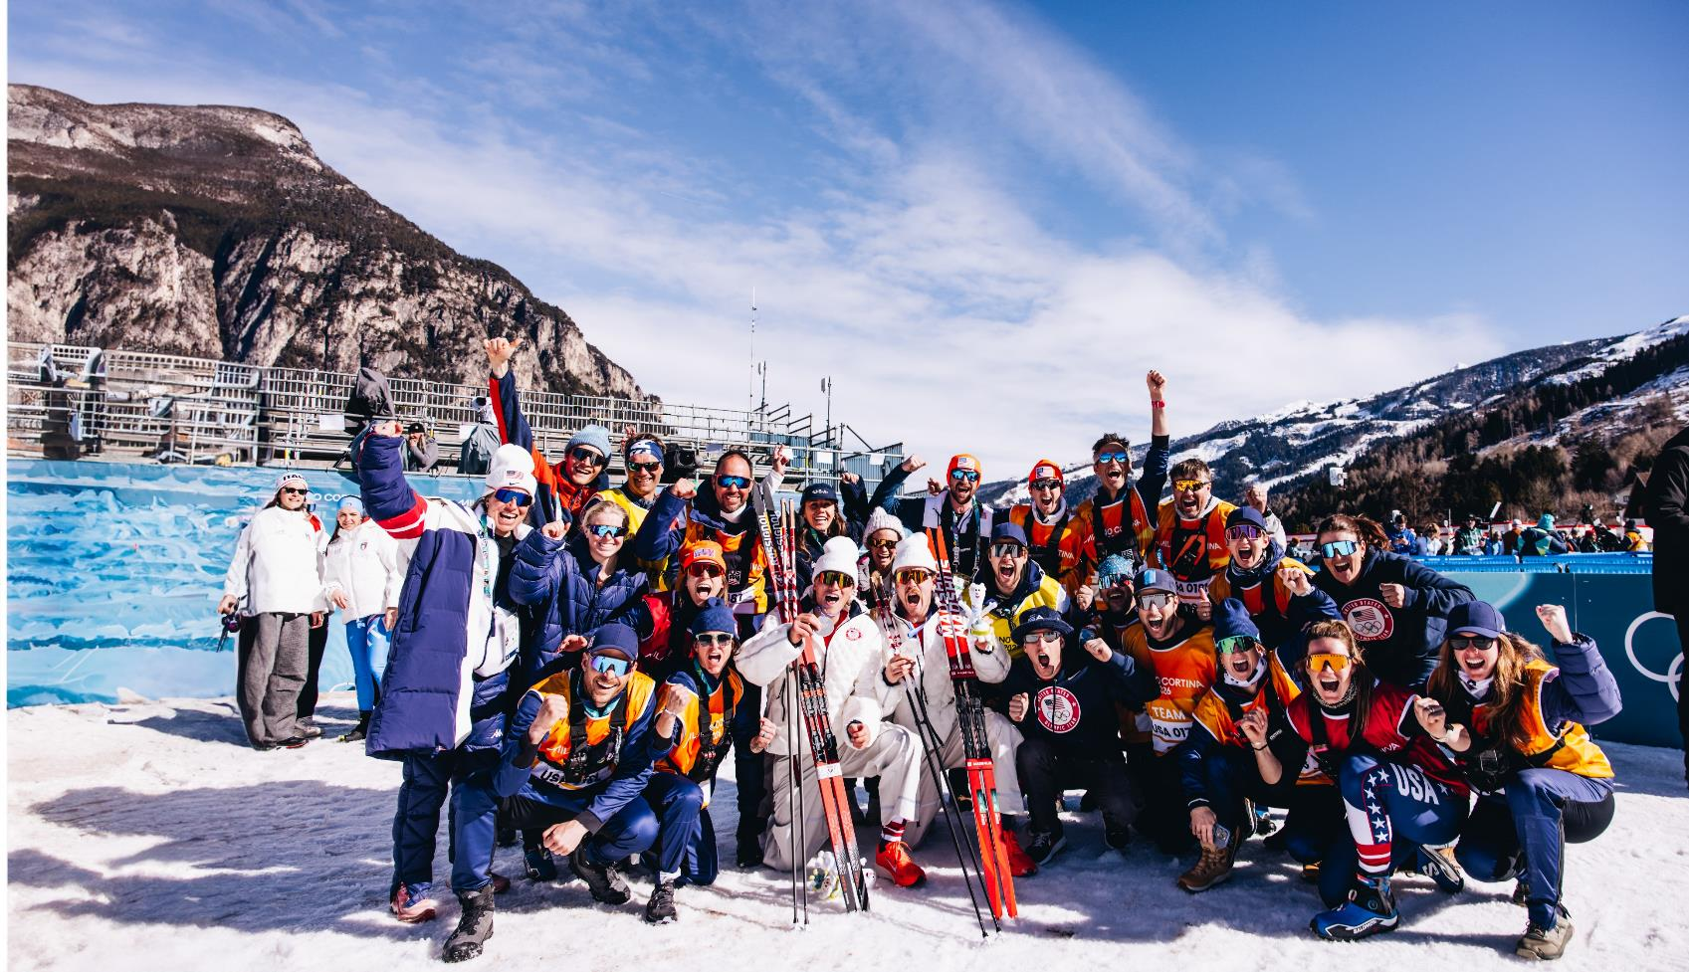
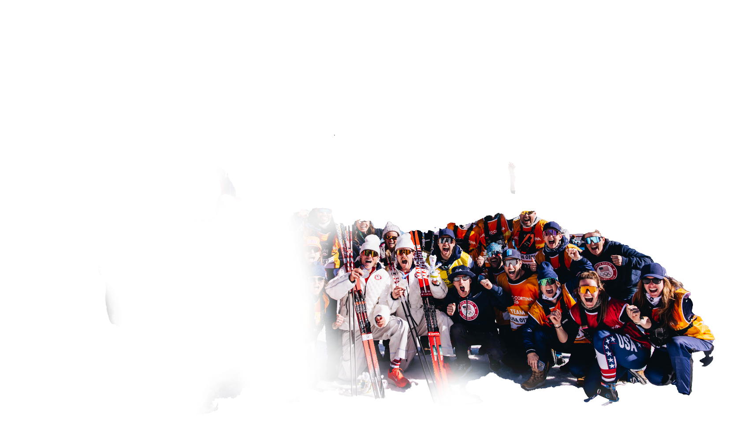

Thank You
Donate Today
Photo Credit: @gpowersfilm

